Slide 1
nodesathome
documentation

Slide 2
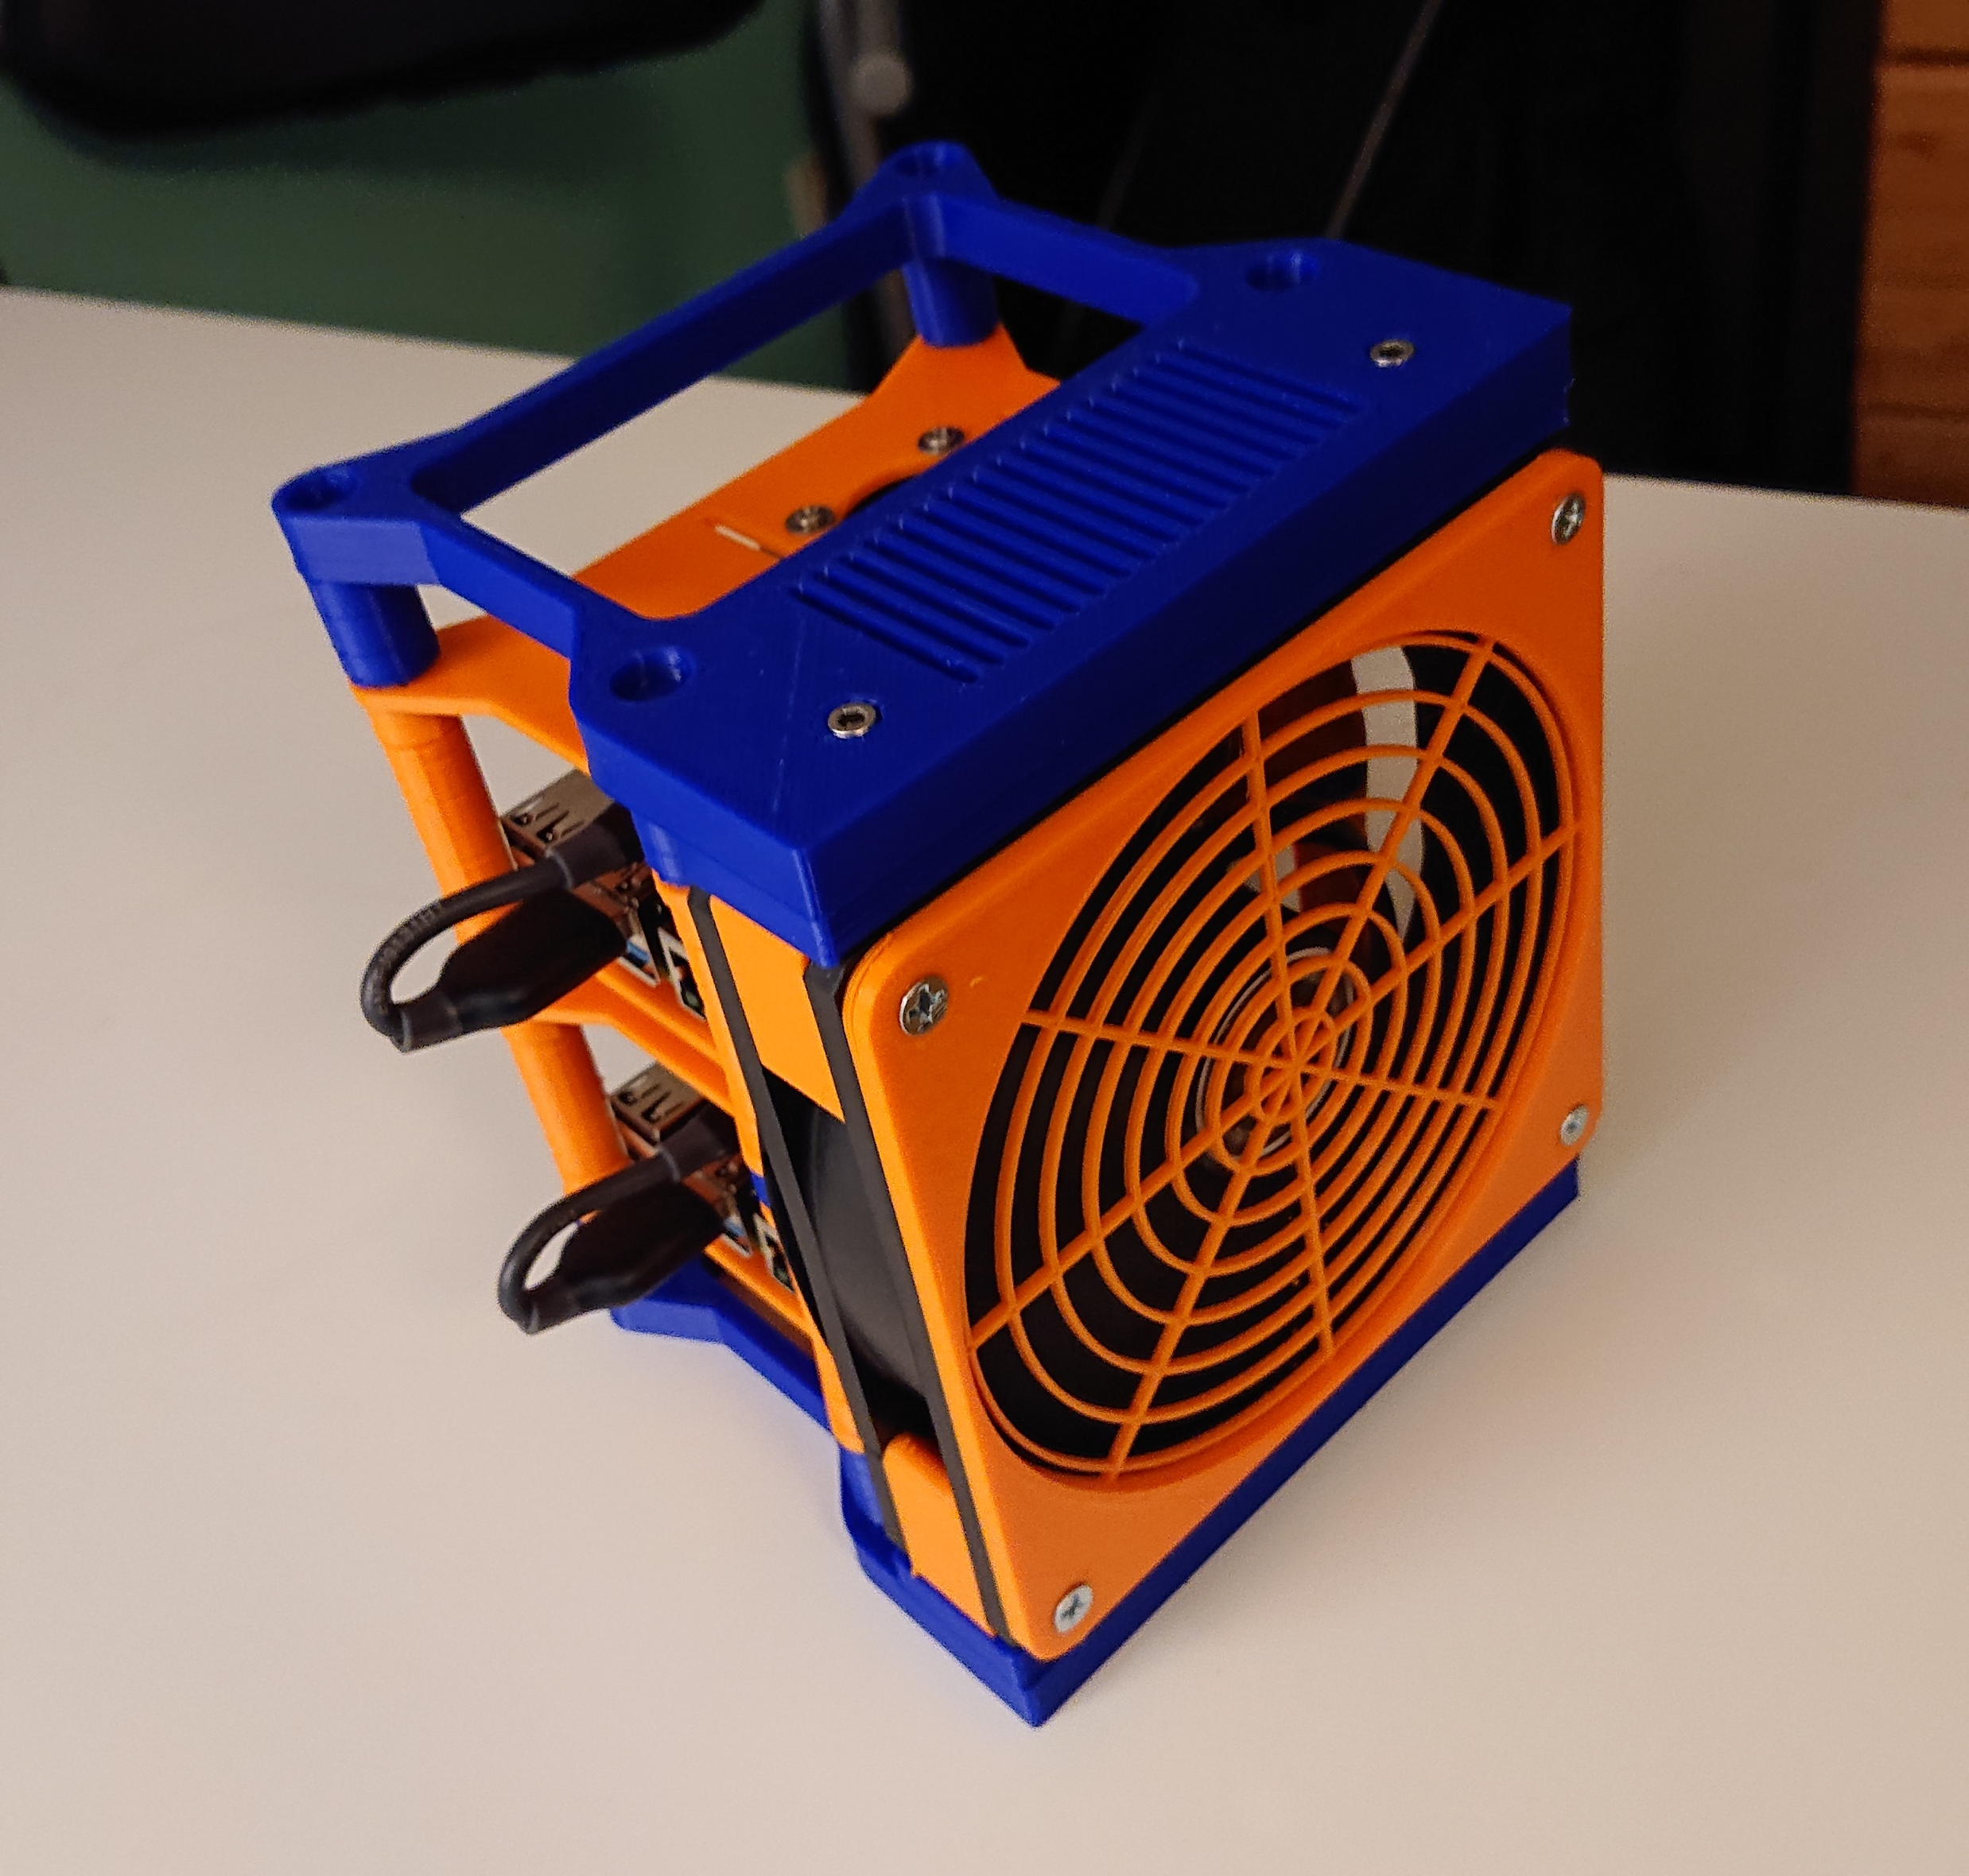
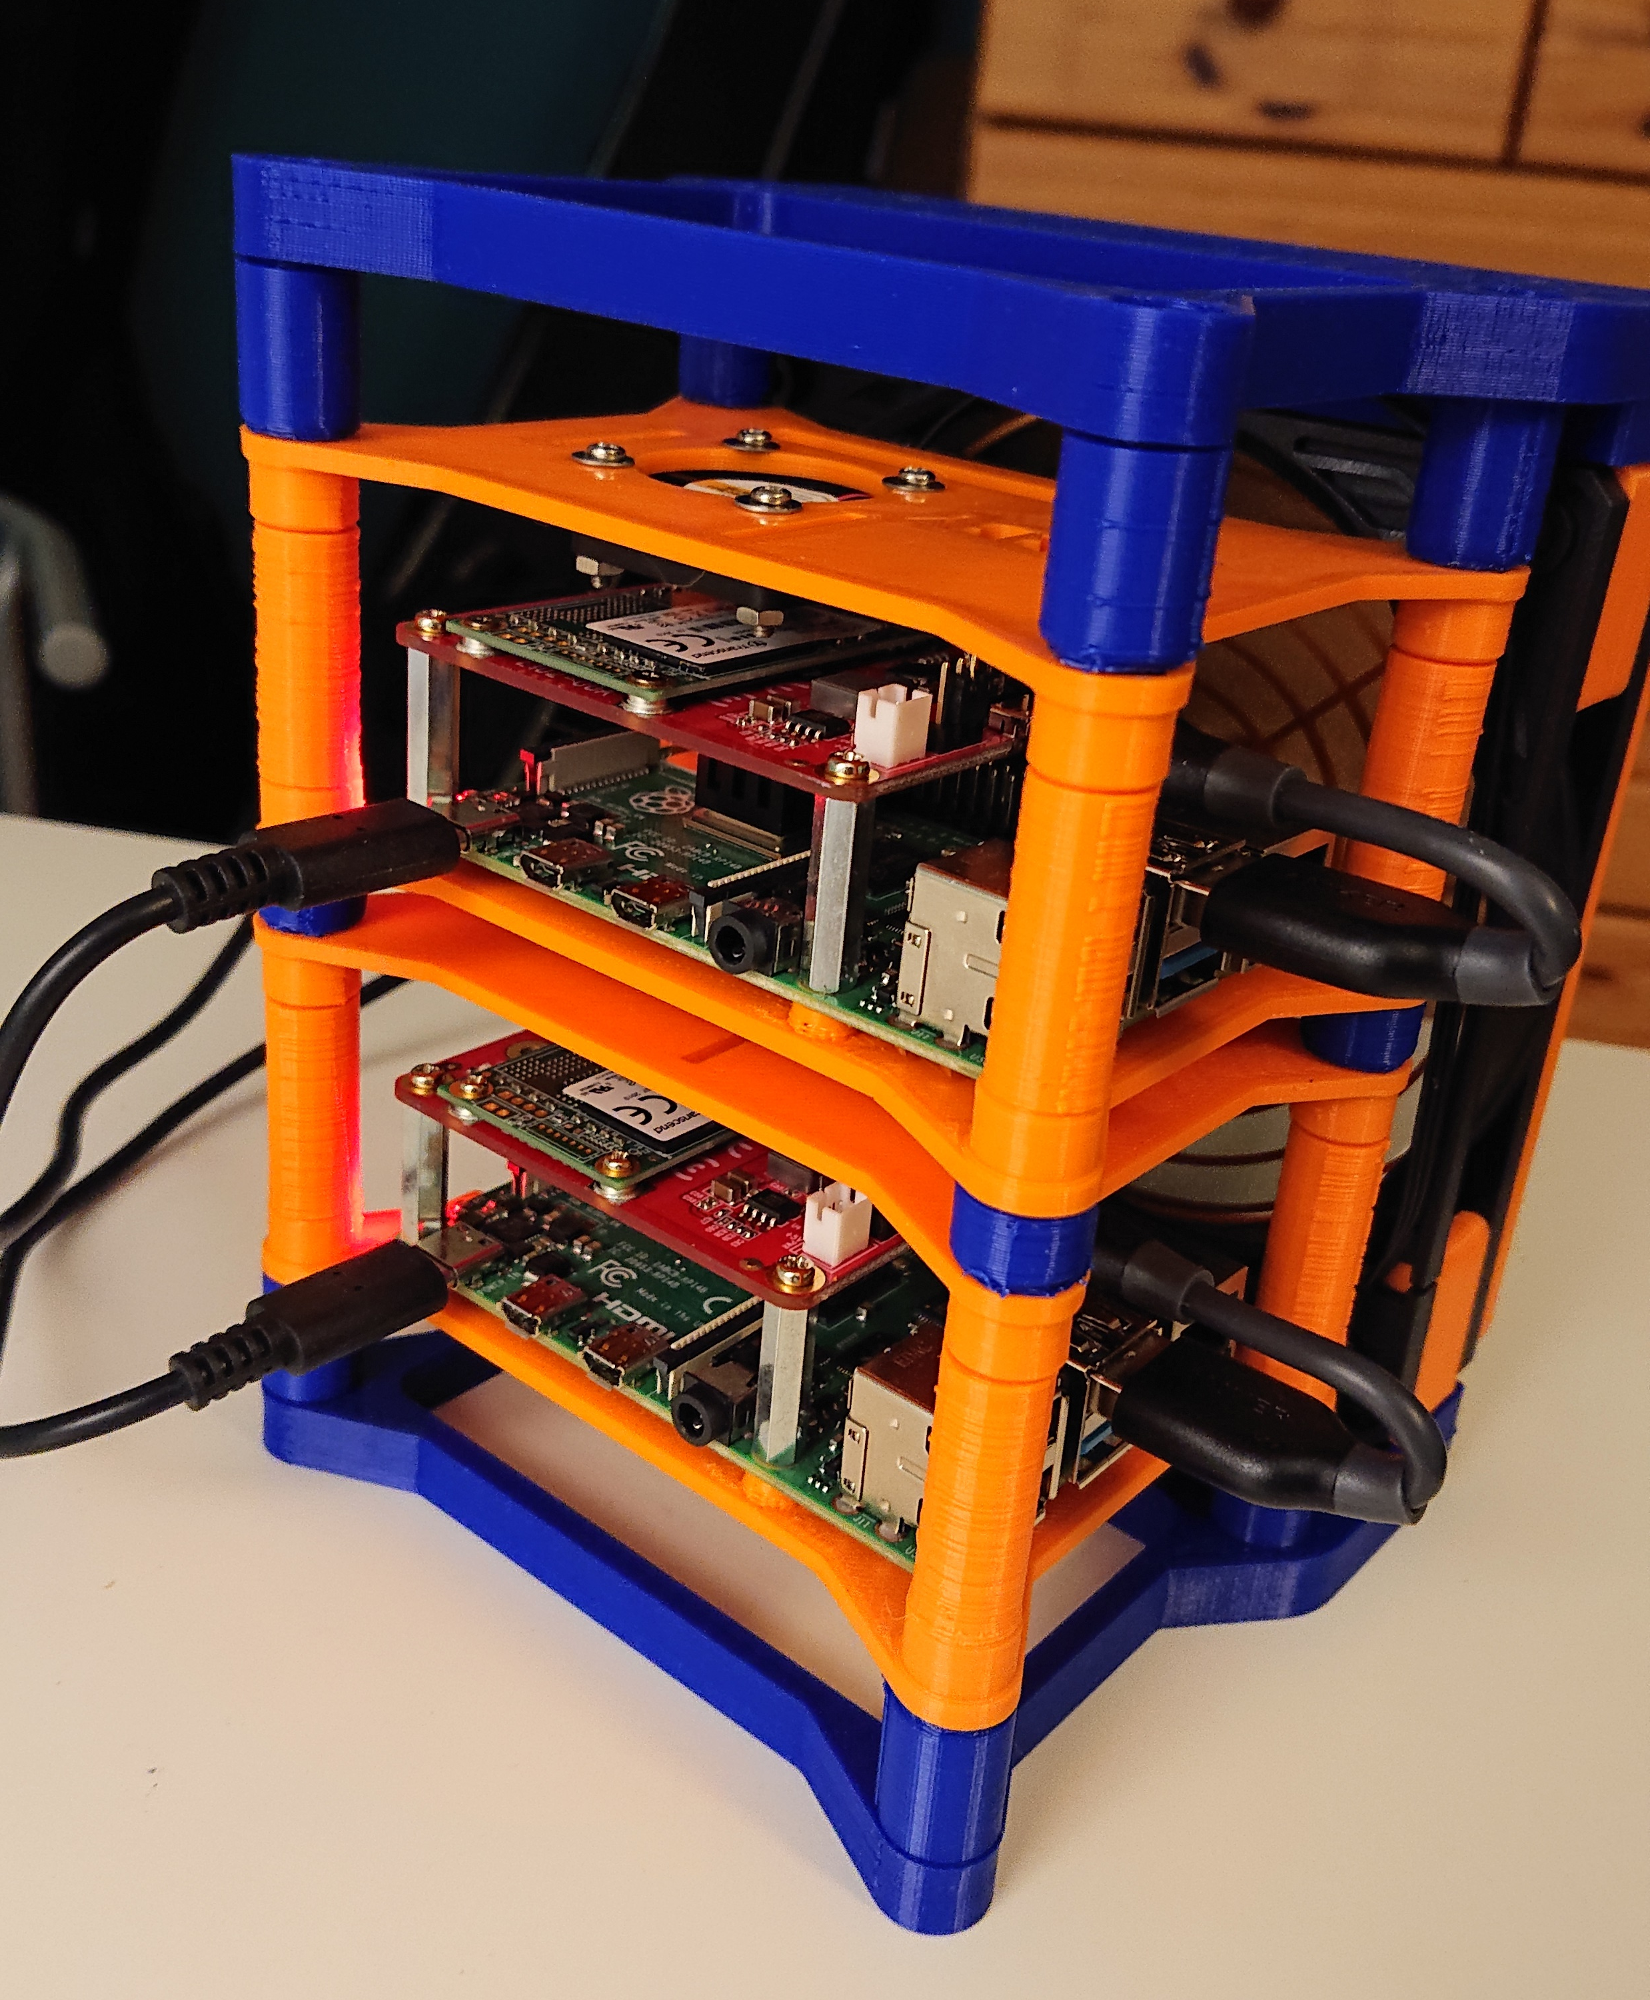
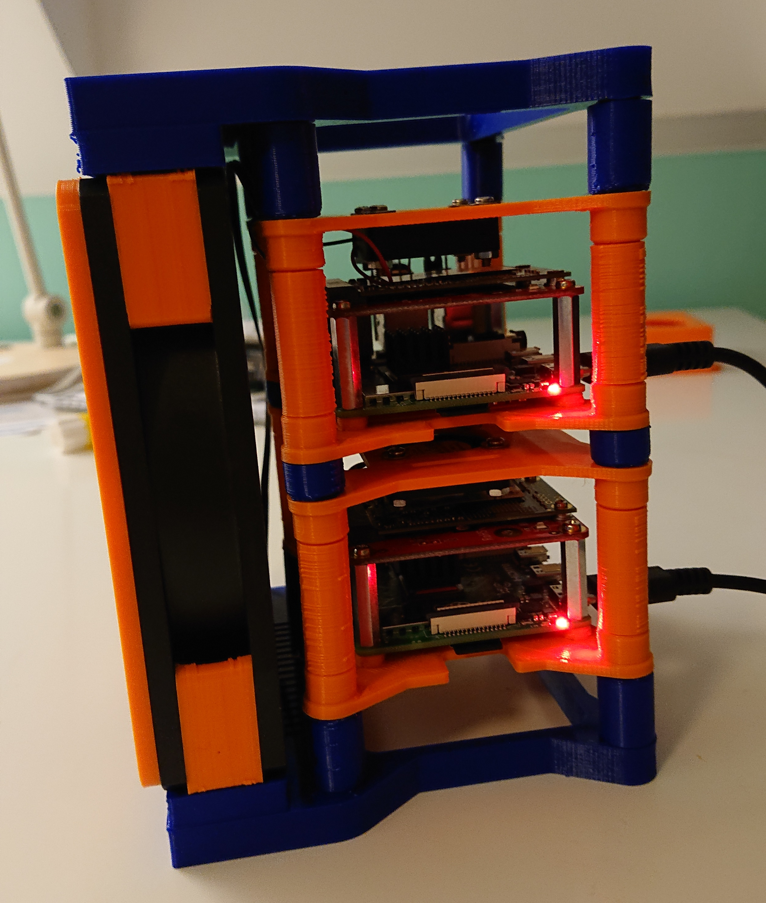
server rack
Zwei Raspberry Pi 4 mit jeweils 4GB Hauptspeicher und 32GB SSD an USB3.0
Two Raspberry Pi 4 with 4GB memory each and 32GB SSD on USB3.0

Slide 3
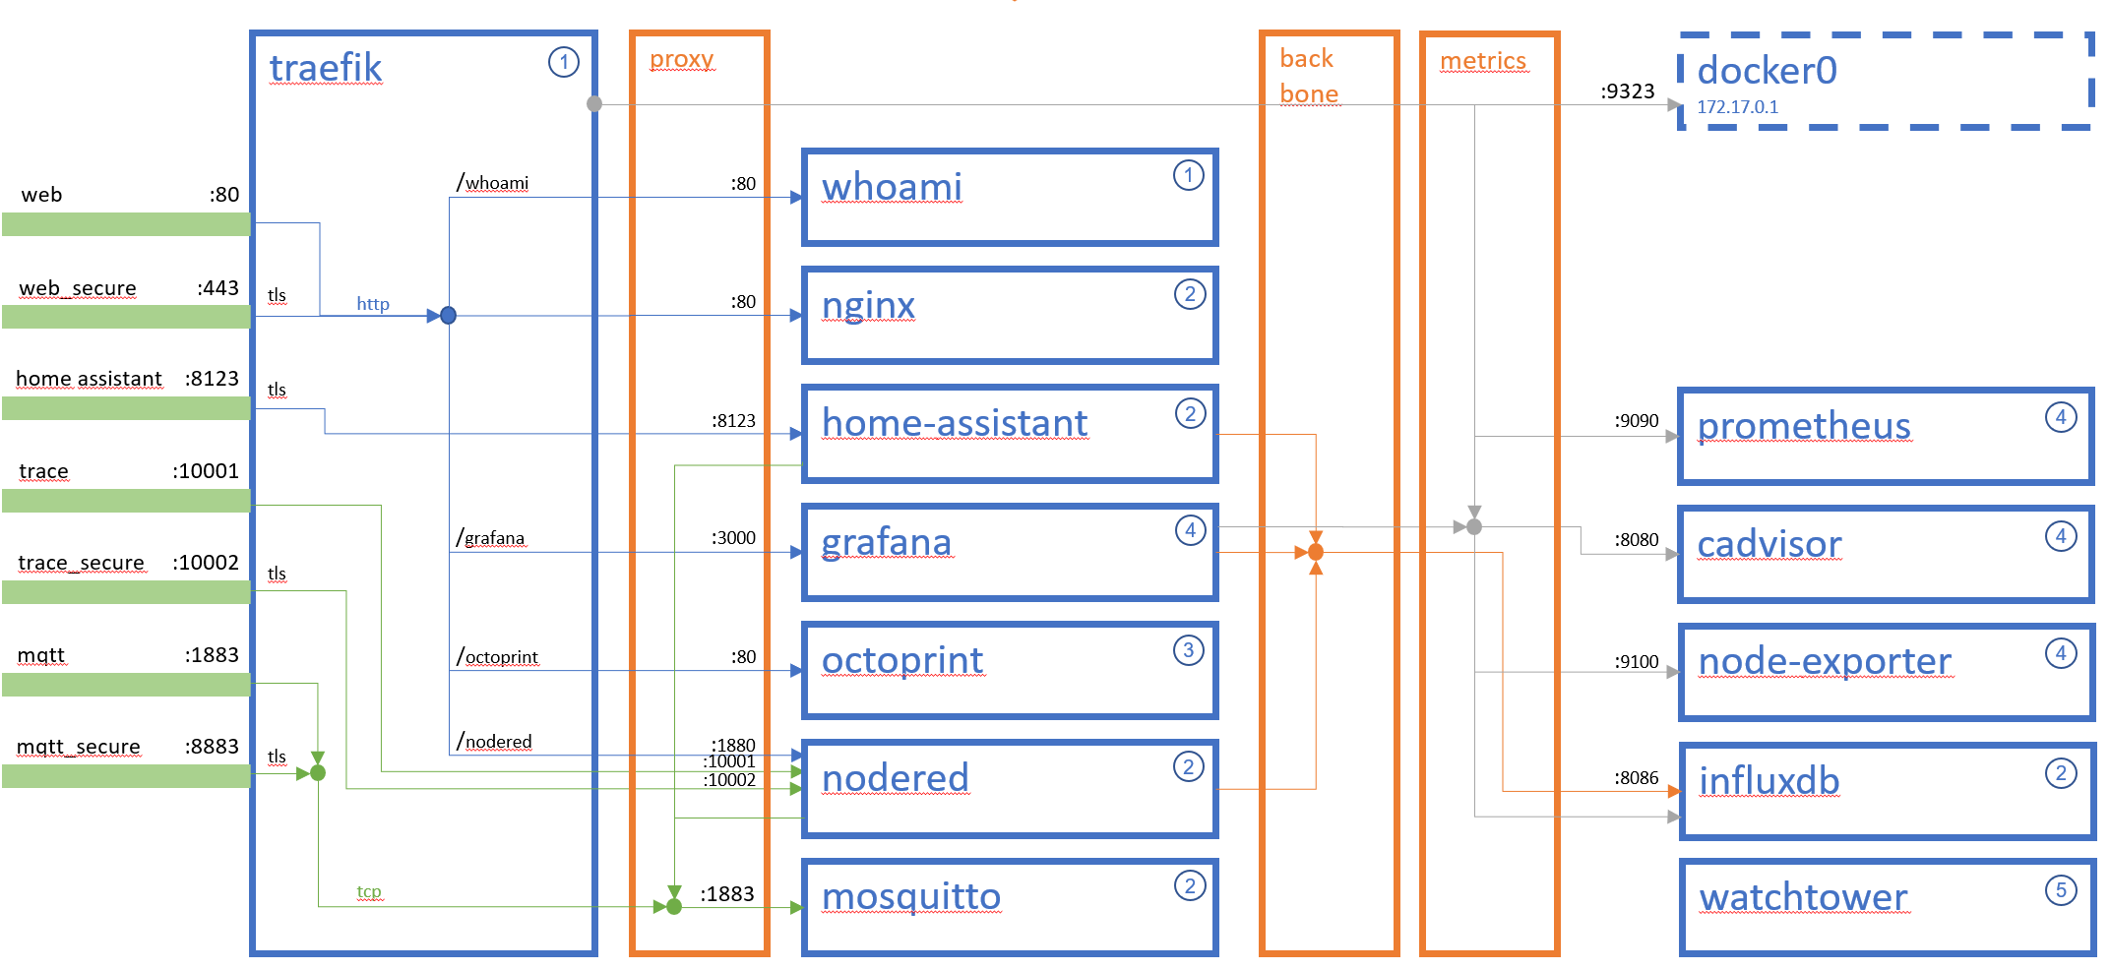
Überblick
surface
Raspberry Pi 4B 4GB
Raspberry Pi 4B 4GB
Raspberry Pi 3B+
nodesathome1 (prod)
nodesathome2 (dev)
pitest (play)
Raspberry Pi 3B
pibrew
pitouch
Raspberry Pi Zero W

Slide 4
nodesathome
1
proxy stack
portainer@surface
2
nodesathome stack
3
printer3d stack
4
metrics stack
5
admin stack
docker
traefik
proxy
back bone
metrics
docker0 172.17.0.1
1
:9323
/whoami
:80
whoami
web :80
1
web_secure :443
tls
:80
nginx
http
2
home assistant :8123
tls
:8123
home-assistant
:9090
prometheus
2
4
trace :10001
/grafana
:3000
grafana
:8080
cadvisor
trace_secure :10002
4
4
tls
mqtt :1883
/octoprint
:80
octoprint
node-exporter
3
:9100
4
mqtt_secure :8883
tls
/nodered
:1880
:10001
nodered
influxdb
:10002
2
:8086
2
:1883
mosquitto
watchtower
tcp
2
5

Slide 5
container dependencies
1
proxy stack
2
nodesathome stack
3
printer3d stack
4
metrics stack
5
admin stack
2
3
grafana
watch tower
1
4
5
traefik
home-assistant
nodered
octo print
whoami
influxdb
mosquitto
prome theus
nginx
node-exporter
cadvisor

